Slide 1
Reading Files

Slide 2
File IO
Java makes it really simple -
File x = new File(“File/location/name”)
Note: For this class, we use File over FileInputStream. The differences come into play much later.
However, you must first understand how files are stored…
Files are …
Memory stored on your disk
Made up of Bits and Bytes (usually people just say bytes)
Contain
Name
Extension (technically optional on some OSes)
So the OS knows what to do with the file
Data.csv
Hello.txt
Index.html

Slide 3
Reading Files in Java
Consider Scanner
Reads in from a Stream
A file is a stream of bytes! Scanner works
Scanner scanner = new Scanner(new File(“input.txt”));
String line = scanner.nextLine(); // this is most common
double dbl = scanner.nextDouble(); // reads the next token, tries to convert to double
scanner.hasNextLine(); // great if grabbing lines only (most common)
scanner.hasNext(); // is true until End of File (EOF).
Putting it together
Scanner in = new Scanner (new File("input.txt"));

Slide 4
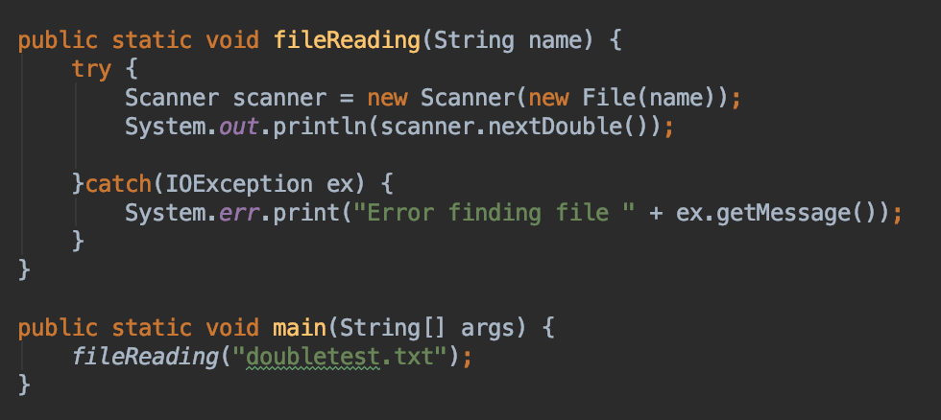
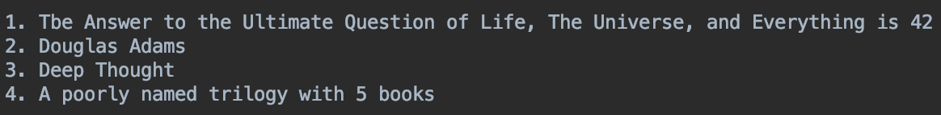
What is printed
1.0

Slide 5
One Line Only
We can access one line
How do we access multiple lines?
Repeat the action!
LOOPS
What methods return true or false in scanner?
hasNextLine() or hasNext()
hasNextLine() is more common
Perfect case for a while loop!
Let’s look at that code

Slide 6
Printing Out Contents
public static void main(Strings[] args) {
try {
Scanner fileHandler = new Scanner(new File(“file.txt”))
while(fileHandler.hasNext()) {
System.out.println(fileHandler.nextLine());
}
}catch(IOException io) {
// what happens if the file is not there??
}
}
contents of file.txt
This is my awesome
file with a number 22.
Look out!
The code would print to the console… This is my awesome file with a number 22.
Look out!

Slide 7
More Useful Case
public static void main(Strings[] args) {
try {
Scanner fileHandler = new Scanner(new File(“file.txt”))
while(fileHandler.hasNext()) {
dosomething(fileHandler.nextLine()); // method that handles strings
}
}catch(IOException io) {System.out.println(“error”);}
}
public static void dosomething(String line) {
// now I can just treat the line as a String
// maybe count the characters?
}

